Slide 1
WELCOME
1

Slide 2

TALLA PADMAVATHI COLLEGE OF ENGINEERING
Approved by ACITE New Delhi-affiliated to JNTU Hyderabad NAAC Accredited-AM ISO 9001-2015 Certified Institution
SOMIDI,KAZIPET,WARANGAL , An Autonomous Institution.
Department of Computer Science & Engineering
A Mini Project Presentation
ON
PREDICTION OF PRE - OWNED CAR PRICES USING MACHINE LEARNING
BATCH-09
UNDER THE GUIDANCE OF
Mrs. J .SHILPA
Assistant Professor,
HOD of CSE Department.
TEAM MEMBERS
MD.SALMA BEGAM - 21UC1A0546
T.ARAVINDA SWAMY - 21UC1A0568
G.POOJITHA - 21UC1A0525
G.SHASHANK - 21UC1A0524
2

Slide 3
CONTENTS
Abstract
Introduction
Literature survey
System analysis
a. Existing system
b. Proposed system
Design
Modules
System Specifications
Code Implementation
Result
Testing
Conclusion
Limitations
References
3

Slide 4
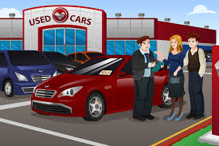
ABSTRACT
The Aim of our project is to predict the price of a used car based on various features , such as vehicle mileage , year of manufacturing , fuel consumption , transmission , road tax , fuel type and engine size etc. The number of cars on roads has been rising Consistently by 5% during the last decade. In 2021 approximately 5,00,000cars were registered at the National Transport Authority. Thus, one member in every six owns a car, most of which are second hand reconditioned cars and used cars . Our project can benefit sellers , buyers and car manufacturers in the used cars market.
4

Slide 5

INTRODUCTION
The model is trained on a dataset of historical car sales data.
The pre-owned automobile market is an ever-increasing industry.
An exact price must be set for both customers and manufacturers.
Machine Learning algorithms are used to develop models.
5

Slide 6

LITERATURE SURVEY
“Prediction of Pre-owned Prices Using Machine Learning Techniques" by M. I. A. Miah, M. S. Aref in, and M. S. Islam (2022).
The study uses a dataset of more than 100,000 used cars .
This paper presents a neural network-based approach .
6

Slide 7
EXISTING SYSTEM
Multiple linear regression analysis, k-nearest neigh bours used to make predictions.
Naive bayes and decision trees have been used to analyze the stock market.
Artificial neural networks used to analyze and predict the market behavior.
Disadvantages:
Data quality problems
Limited data availability
Overfitting
7

Slide 8
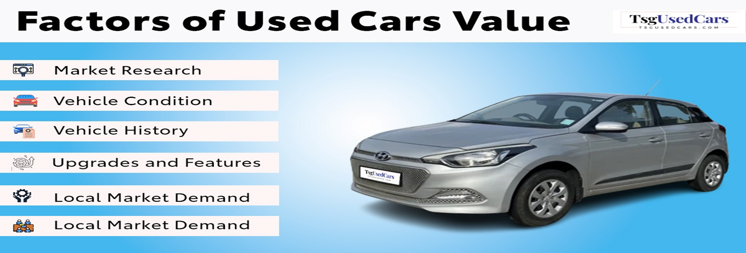
PROPOSED SYSTEM
Creating a Web Application for pre- owned cars.
Data have been obtained from different car websites and daily newspapers.
The data was collected in less than one month interval.
The data comprises of different features for pre-owned cars.
8

Slide 9
DESIGN
To design the module in diagram Format we use UML diagrams which will make this project easier to understand.
Use case diagram.
Class diagram.
State chart diagram.
Sequence diagram.
Data flow diagram
9

Slide 10
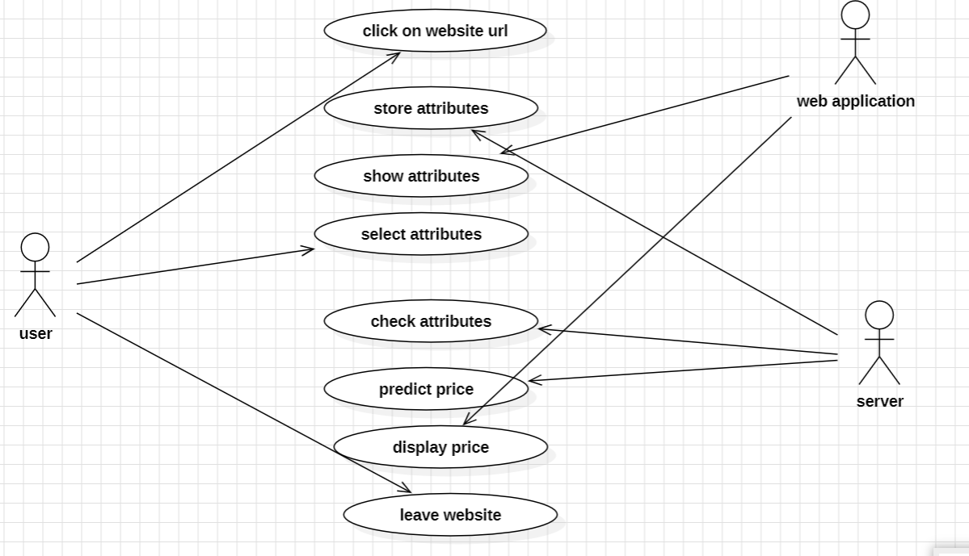
USECASE DIAGRAM
10

Slide 11
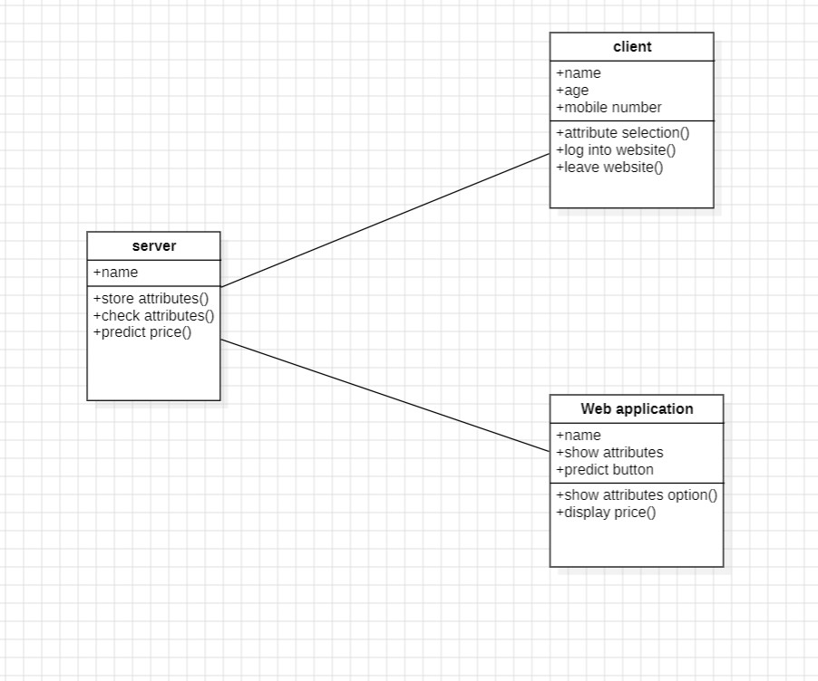
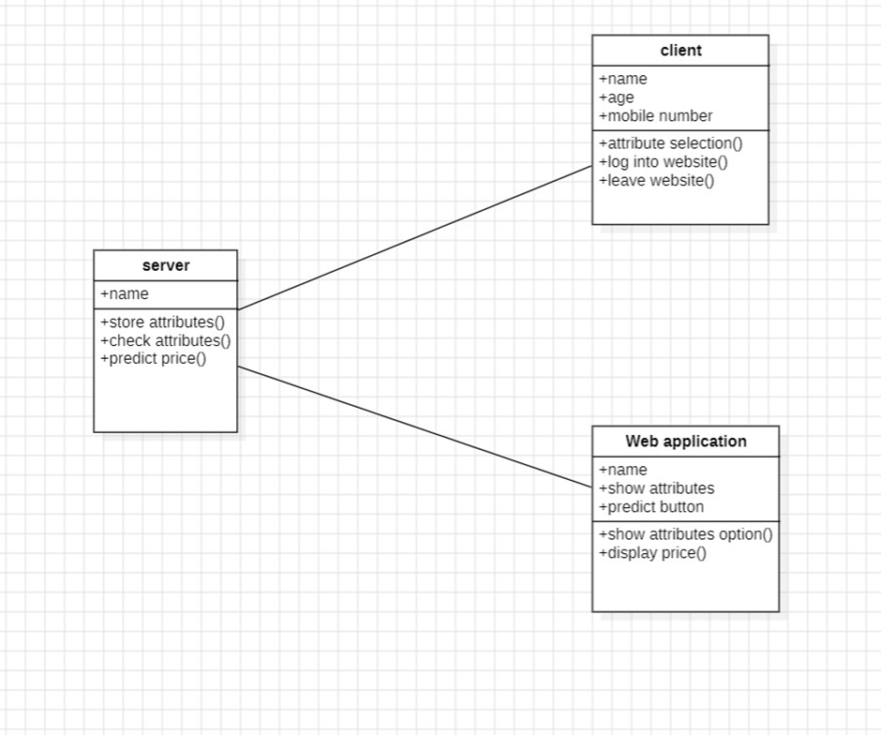
CLASS DIAGRAM
11

Slide 12
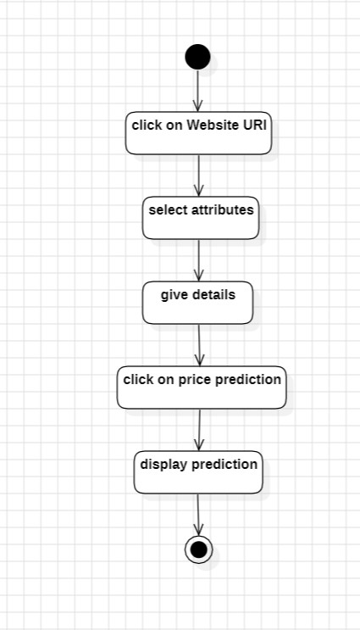
STATE CHART DIAGRAM
12

Slide 13
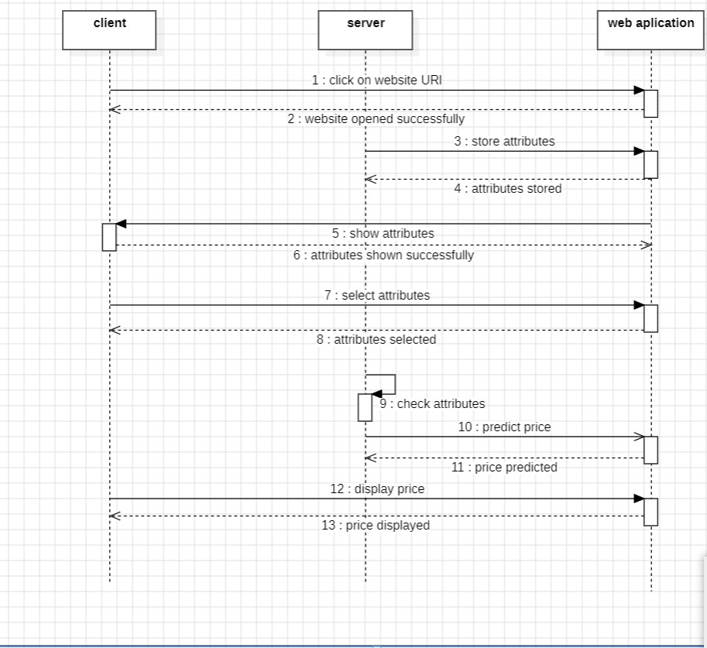
SEQUENCE DIAGRAM
13

Slide 14
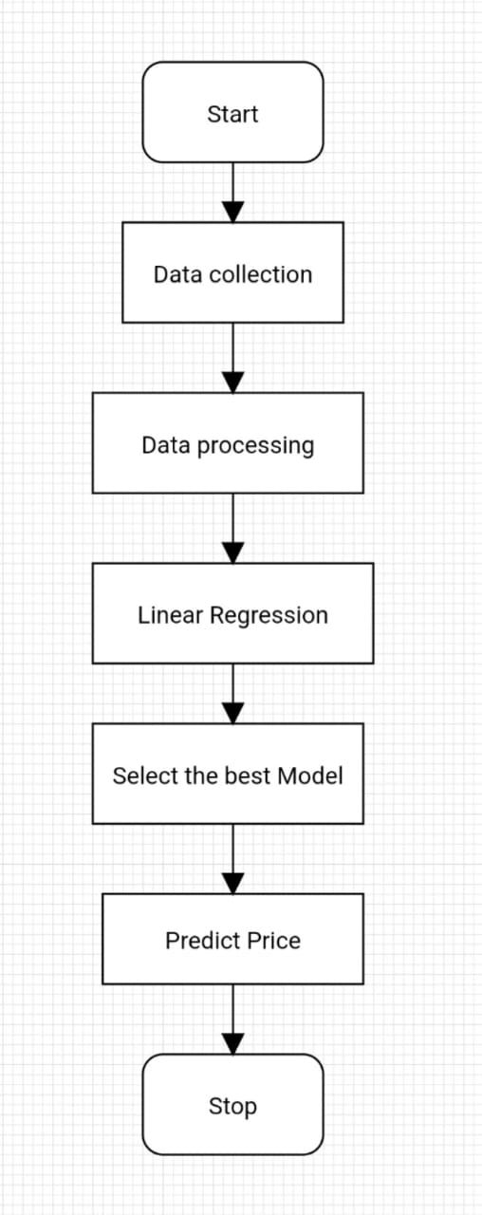
DATA FLOW DIAGRAM
14

Slide 15
MODULES
Data collection
Preprocessing
Data splitting
Applying ML algorithms
Comparing performance
prediction
15

Slide 16
SYSTEM SPECIFICATIONS
Software Requirements:
Operating System : Min . Windows 7
Coding Language : Python
Hardware Requirements:
Processor : Intel core i5
RAM : 4GB
Hard Disk : 20 GB
16

Slide 17
CODE:
FRONT-END
import pandas as pd
import numpy as np
import pickle as pk
import streamlit as st
model = pk.load(open('model.pkl’,’rb’))
st.header('Car Price Prediction ML Model’)
cars_data = pd.read_csv('Cardetails.csv’)
def get_brand_name(car_name):
car_name = car_name.split(' ')[0]
return car_name.strip()
17

Slide 18
cars_data['name'] = cars_data['name'].apply(get_brand_name)
name = st.selectbox('Select Car Brand', cars_data['name'].unique())
year = st.slider('Car Manufactured Year', 1994,2024)
km_driven = st.slider('No of kms Driven', 11,200000)
fuel = st.selectbox('Fuel type', cars_data['fuel'].unique())
seller_type = st.selectbox('Seller type',cars_data['seller_type'].unique())
transmission = st.selectbox('Transmission type', cars_data['transmission'].unique())
owner = st.selectbox('Seller type', cars_data['owner'].unique())
mileage = st.slider('Car Mileage', 10,40)
engine = st.slider('Engine CC', 700,5000)
max_power = st.slider('Max Power', 0,200)
seats = st.slider('No of Seats', 5,10)
18

Slide 19
if st.button("Predict"):
input_data_model = pd.DataFrame
([[name,year,km_driven,fuel,seller_type,transmission,owner,mileage,engine,max_power,seats]],columns=['name','year','km_driven','fuel','seller_type','transmission','owner','mileage','engine','max_power','seats’])
input_data_model['owner'].replace(['First Owner', 'Second Owner', 'Third Owner', 'Fourth & Above Owner', 'Test Drive Car'], [1,2,3,4,5], inplace=True)
input_data_model['fuel'].replace(['Diesel', 'Petrol', 'LPG', 'CNG'],[1,2,3,4], inplace=True)
input_data_model['seller_type'].replace(['Individual', 'Dealer', 'Trustmark Dealer'],[1,2,3], inplace=True)
input_data_model['transmission'].replace(['Manual', 'Automatic'],[1,2], inplace=True)
19

Slide 20
input_data_model['name'].replace(['Maruti', 'Skoda', 'Honda', 'Hyundai', 'Toyota', 'Ford', 'Renault', 'Mahindra', 'Tata', 'Chevrolet', 'Datsun', 'Jeep', 'Mercedes-Benz', 'Mitsubishi', 'Audi', 'Volkswagen', 'BMW', 'Nissan', 'Lexus', 'Jaguar', 'Land', 'MG', 'Volvo', 'Daewoo', 'Kia', 'Fiat', 'Force', 'Ambassador', 'Ashok', 'Isuzu', 'Opel'], [1,2,3,4,5,6,7,8,9,10,11,12,13,14,15,16,17,18,19,20,21,22,23,24,25,26,27,28,29,30,31],inplace=True)
car_price = model.predict(input_data_model)
st.markdown('Car Price is going to be '+ str(car_price[0]))
20

Slide 21
BACK-END
import pandas as pd
import numpy as np
from sklearn.model_selection import train_test_split
from sklearn.linear_model import LinearRegression
cars_data = pd.read_csv('Cardetails.csv’)
cars_data.head()
cars_data.drop(columns=['torque'], inplace=True)
cars_data.head()
cars_data.shape
cars_data.isnull().sum()
cars_data.dropna(inplace=True)
cars_data.shape
cars_data.duplicate().sum()
21

Slide 22
cars_data.drop_duplicates(inplace=True)
cars_data.shape
cars_data
cars_data.info()
#Data Analysis
for col in cars_data.columns:
print('Unique values of ' + col)
print(cars_data[col].unique())
print("======================")
def get_brand_name(car_name):
car_name = car_name.split(' ')[0]
return car_name.strip()
def clean_data(value):
value = value.split(' ')[0]
value = value.strip()
22

Slide 23
if value == '':value = 0
return float(value)
get_brand_name('Maruti Swift Dzire VDI’)
cars_data['name'] = cars_data['name'].apply(get_brand_name)
cars_data['name'].unique()
cars_data['mileage'] = cars_data['mileage'].apply(clean_data)
cars_data['max_power'] = cars_data['max_power'].apply(clean_data)
cars_data['engine'] = cars_data['engine'].apply(clean_data)
for col in cars_data.columns:
print('Unique values of ' + col)
print(cars_data[col].unique())
print("======================")
cars_data['name'].replace(['Maruti', 'Skoda', 'Honda', 'Hyundai', 'Toyota', 'Ford', 'Renault', 'Mahindra', 'Tata', 'Chevrolet', 'Datsun', 'Jeep', 'Mercedes-Benz',
23

Slide 24
'Mitsubishi', 'Audi', 'Volkswagen', 'BMW', 'Nissan', 'Lexus', 'Jaguar', 'Land', 'MG', 'Volvo', 'Daewoo', 'Kia', 'Fiat', 'Force', 'Ambassador', 'Ashok', 'Isuzu', 'Opel’], [1,2,3,4,5,6,7,8,9,10,11,12,13,14,15,16,17,18,19,20,21,22,23,24,25,26,27,28,29,30,31] ,inplace=True)
cars_data['transmission'].unique()
cars_data['transmission'].replace(['Manual', 'Automatic'],[1,2],inplace=True)
cars_data['seller_type'].unique()
cars_data['seller_type'].replace(['Individual', 'Dealer', 'Trustmark,Dealer’] ,[1,2,3], inplace=True)
cars_data.info()
cars_data['fuel'].unique()
cars_data['fuel'].replace(['Diesel', 'Petrol', 'LPG', 'CNG'],[1,2,3,4], inplace=True)
24

Slide 25
cars_data.reset_index(inplace=True)
cars_data
cars_data['owner'].unique()cars_data['owner'].replace(['First Owner', 'Second Owner', 'Third Owner','Fourth & Above Owner', 'Test Drive Car'], [1,2,3,4,5], inplace=True)
cars_data.drop(columns=['index'], inplace=True)
for col in cars_data.columns:
print('------------’)
print(col)
print(cars_data[col].unique())
cars_data.isnull().sum()
input_data = cars_data.drop(columns=['selling_price’])
output_data =cars_data['selling_price’]
x_train, x_test, y_train, y_test = train_test_split(input_data, output_data, test_size=0.2)
25

Slide 26
model = LinearRegression()
#Train Model
model.fit(x_train, y_train)
predict = model.predict(x_test)
Predict
x_train.head(1)
input_data_model = pd.DataFrame([[5,2022,120000,1,1,1,1,1,12.99,2429.0,100.6,5.0]], columns=['name','year','km_driven','fuel','seller_type','transmission','owner','mileage','engine','max_power','seats’])
input_data_model
model.predict(input_data_model)
import pickle as pk
pk.dump(model,open('model.pkl','wb'))
26

Slide 27
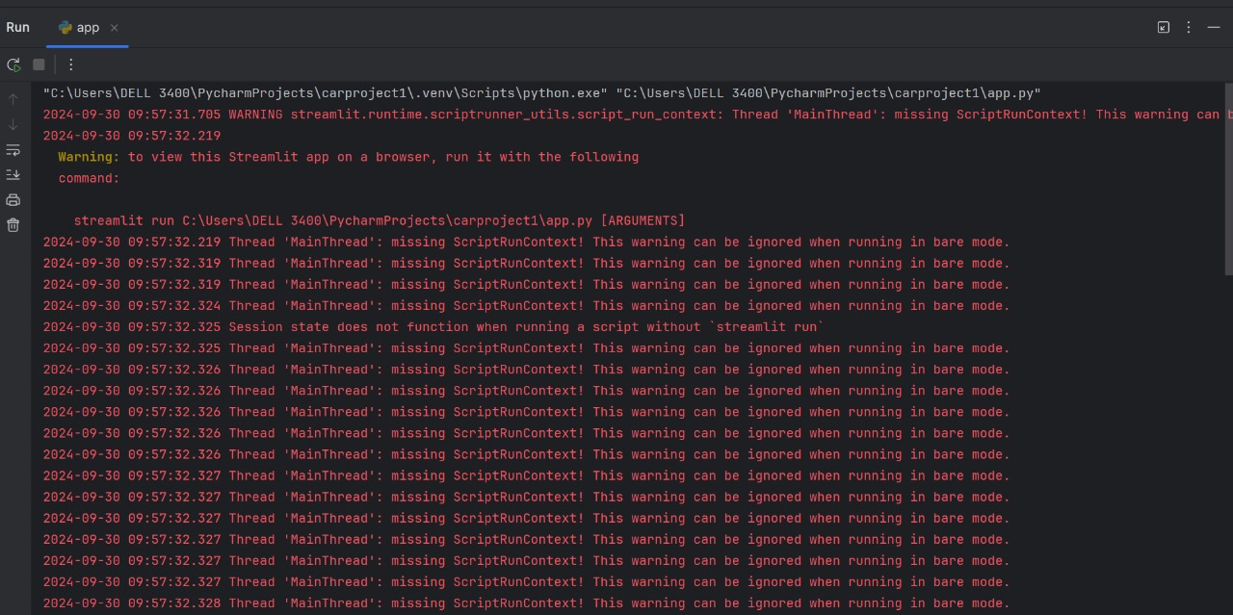
RESULT
27
27

Slide 28
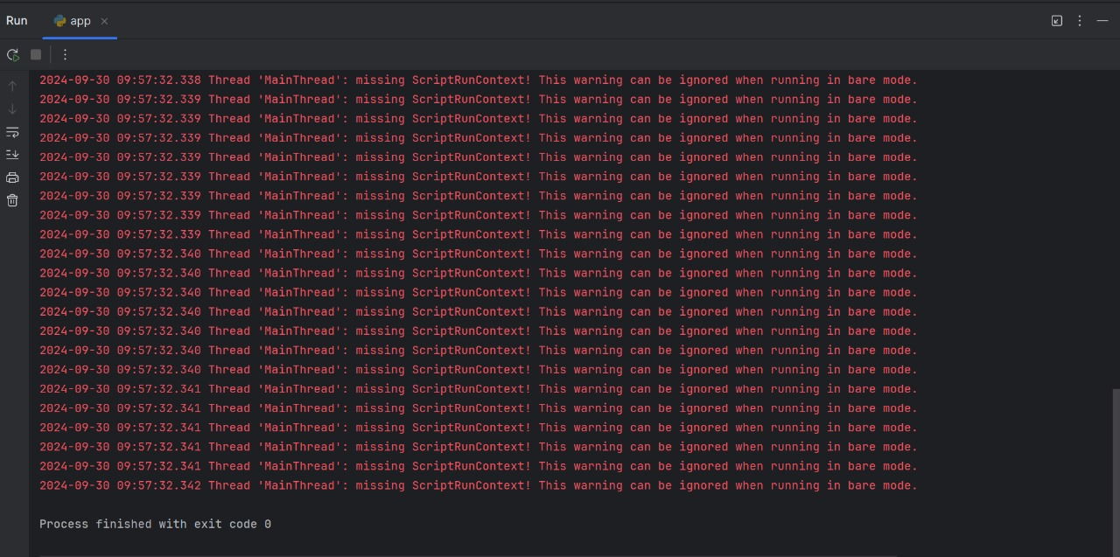
28

Slide 29
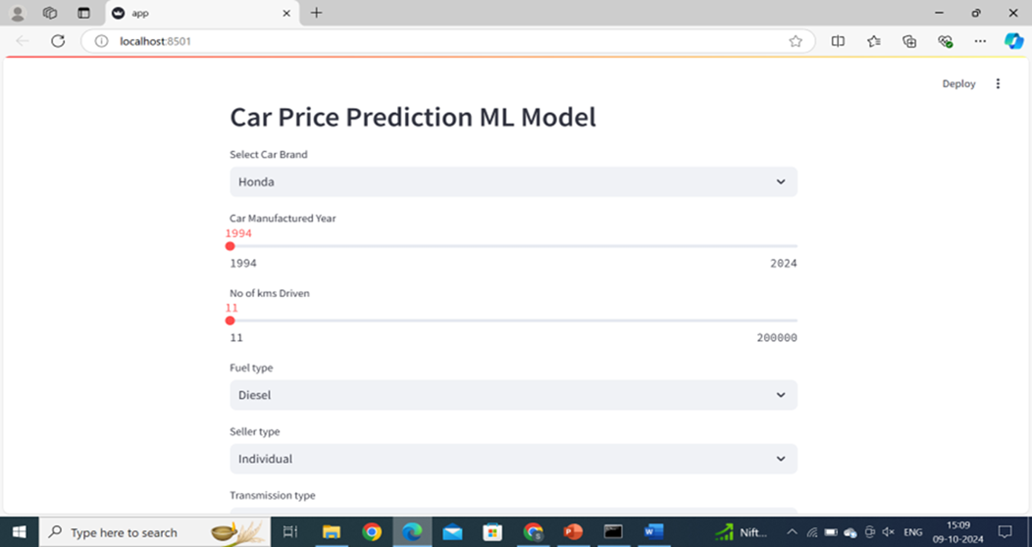
29

Slide 30
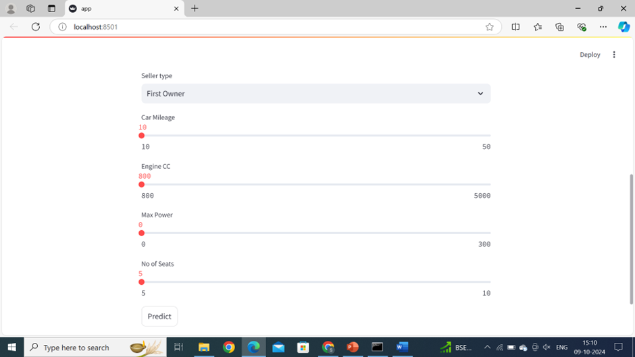
30

Slide 31
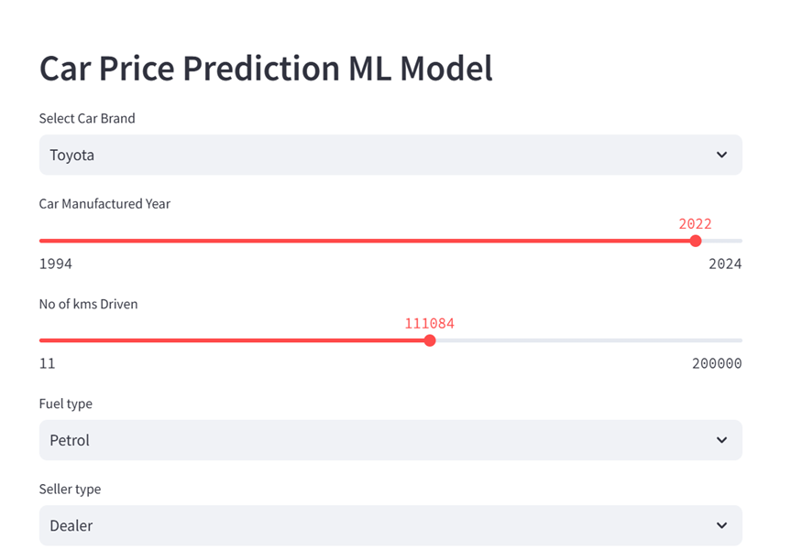
31

Slide 32
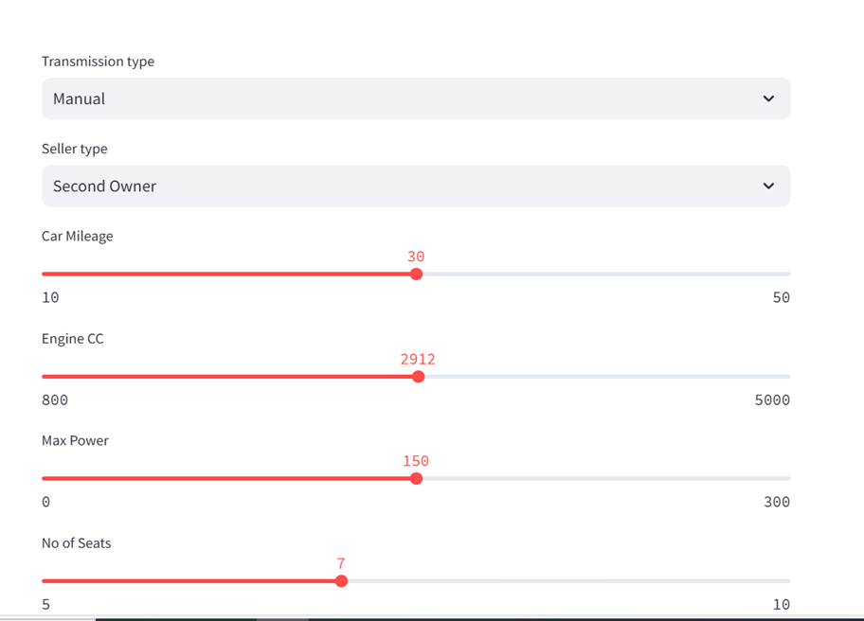
32

Slide 33
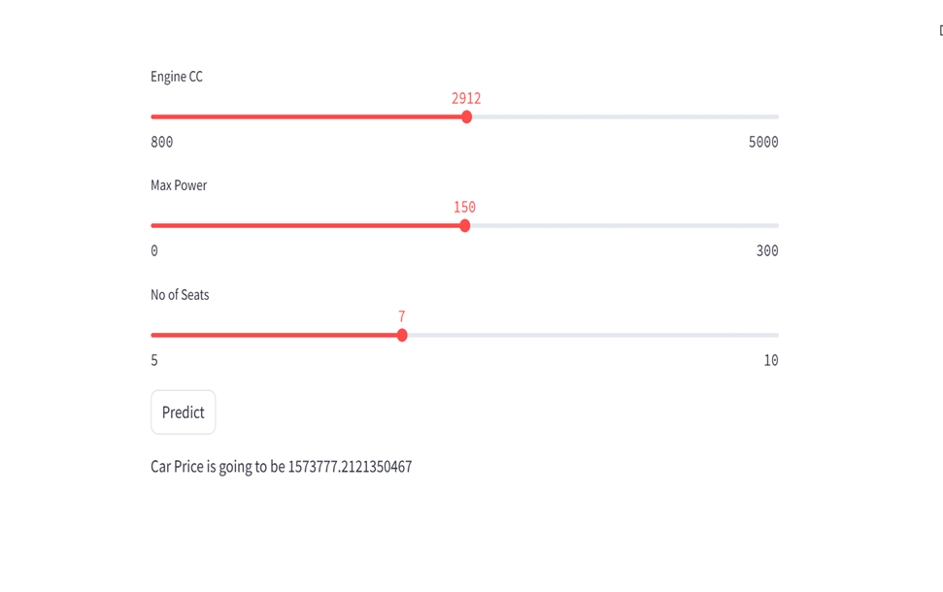
33

Slide 34
TESTING
System Testing.
White Box Testing.
Black Box Testing.
Unit testing.
34

Slide 35
CONCLUSION
The model we were making is to predict the value of a pre-owned car using machine learning techniques. We have collected the data of cars having attributes like manufactured year, km driven, fuel type, model name, company, seller type, car mileage etc. The data is then processed using different algorithms where we chose linear regression and random forest algorithms and compared them. It would be available in GUI as a Web application developed using Python flask making it user-friendly so that users could give input and get the price of a car according to it.
35

Slide 36
LIMITATIONS
Used car prices are not constant in the market.
We can predict only one car price at a time.
36

Slide 37
REFERENCES
Hsieh, M. H., Huang, C. Y., Lin, C. J., & Liou , J. J. (2017). Prediction of used car prices using artificial neural networks. Journal of Intelligent Manufacturing, 28(5), 1035-1044.
Jain, A., Kaur, P., & Jain, A. (2019). Prediction of Used Car Prices Using Machine Learning Techniques. In 2019 3rd International Conference on Trends in Electronics and Informatics (ICOEI) (pp. 1257-1260).ΙΕΕΕ
Wang, X., Wu, J., & Xie, G. (2021). An empirical study of used car price prediction based on machine learning algorithms. Journal of Cleaner Production, 317, 128215.
Khoshgoftaar , T. M., & Van Hulse, J. (2010). An empirical study of learning from imbalanced data using random forest. In Proceedings of the 19th International Conference on Pattern Recognition (ICPR) (pp. 553-556). ΙΕΕΕ .
"Prediction of Used Car Prices Using Machine Learning Techniques" by M. I. A. Miah, M. S. Are fin, and M. S. Islam. (2022)
Predicting Used Car Prices Using Neural Networks(2022)" by A. F. Rahman, M. A. Uddin, and M. M. Islam .
"A Hybrid Machine Learning Approach for Predicting Used Car Prices" by S. Yousuf and M. Uddin (2022).
37

Slide 38

38

Slide 39

39

